Slide 1
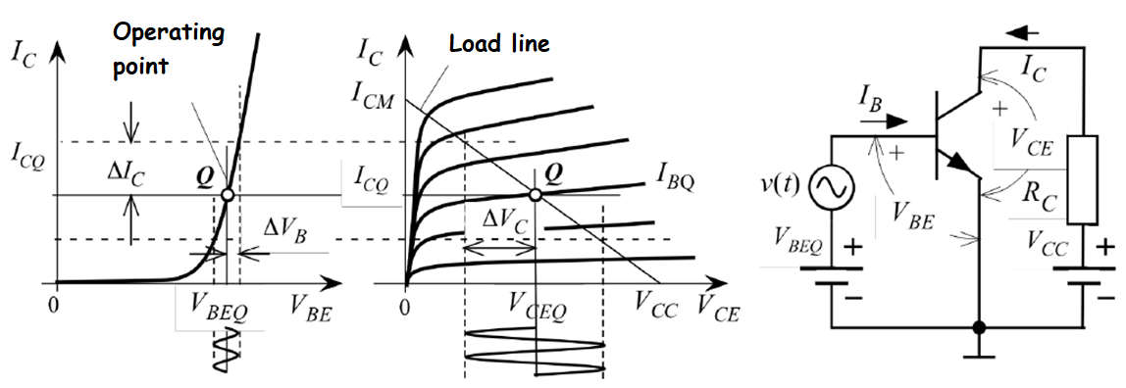
Small Signal Behavior of the Transistor
Demonstration of the small changes
Since the current and voltage relations of BJT are not linear, electronic circuits containing BJt cannot be resolved by known linear circuit analysis methods.
For this, some parameters belonging to the transistor can be obtained and a small signal model can be established.
Since the small signal model consists of linear elements, it can be easily analyzed.

Slide 2

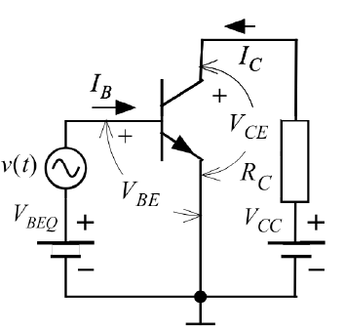


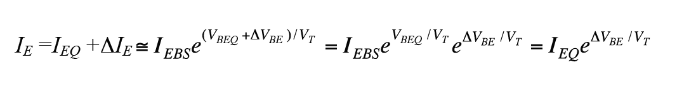
Small Signal Behavior of the Transistor
Add a small signal to the input and in this case, VBEQ base emitter voltage increases by . at the input. In this case, there will be a base-emitter voltage as and the emitter current will also increase:

Slide 3
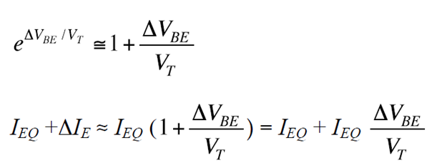
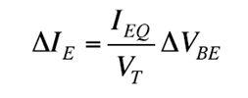
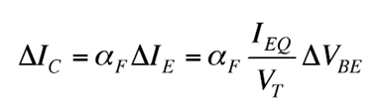
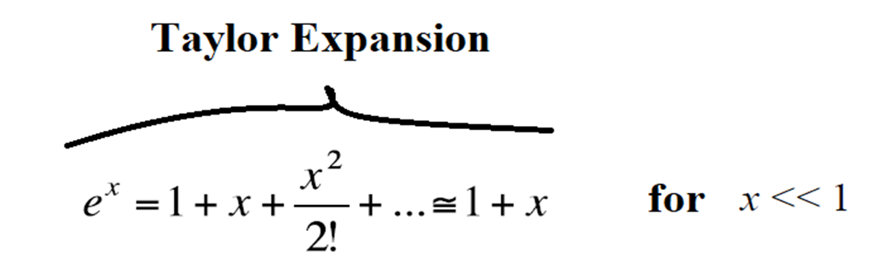
Small Signal Behavior of the Transistor
If it is used:
If abbreviations are made:
The corresponding change in the collector current is:

Slide 4
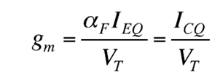
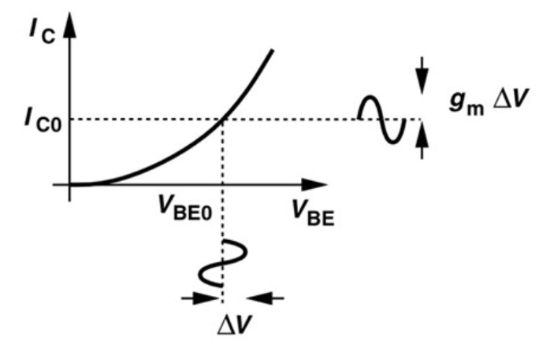

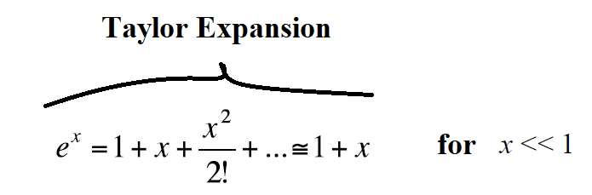
Small Signal Behavior of the Transistor
If the gm trans-conductance parameter is defined here:

Slide 5
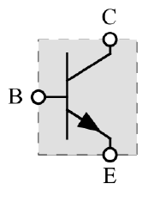

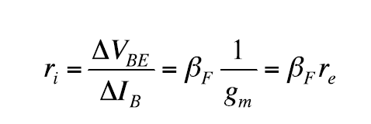
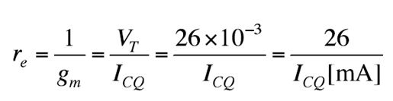
Small Signal Behavior of the Transistor
The variation in base current can be derived from the formula:
In this case, the equivalent resistance seen from the base-emitter terminal of the transistor:
Here,
It is a dynamic emitter resistance, an important parameter of the transistor.

Slide 6



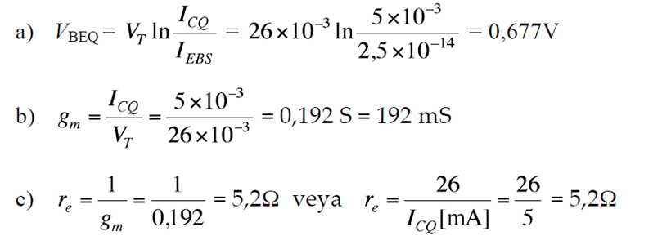
EXAMPLE: DC current operating point of a bipolar transistor is given as
Calculate the VBE operating voltage of the transistor.
Calculate the trans-conductance value of the transistor.
Calculate the dynamic emitter resistance of the transistor.

Slide 7
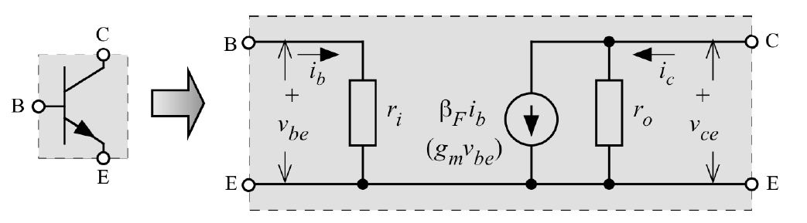
Equivalent Circuit of Bipolar Transistor
Small Signal Model of the BJT Transistor

Slide 8
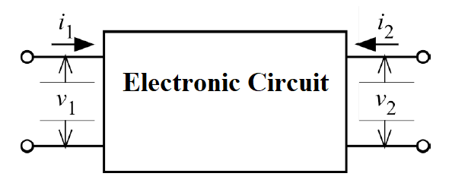
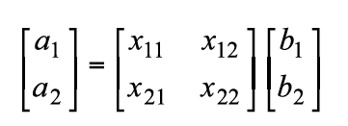
Parametric Equivalent Circuit
The relationship of input-output currents and voltages of a two-gates element can be defined parametrically.
If two of these variables known, the other two can be calculated with the help of parameters.
This relationship can be written as a matrix equation.
Parametric representation of electronic circuit or element

Slide 9
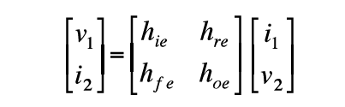
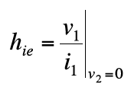
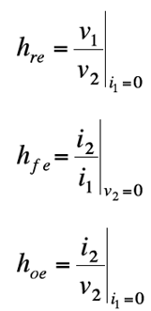
Parametric Equivalent Circuit
The current-voltage relations of a transistor circuit are shown in hybrid parameters as follows.
Input resistance when output is short circuit
Voltage from output to input when input is open circuit
Current gain when output is short circuit
Output conductance when input is open circuit

Slide 10

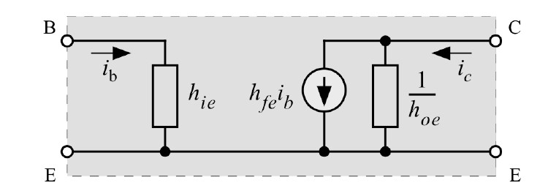
Parametric Equivalent Circuit
Dependent current source
h- parameters equivalent circuit

Slide 11
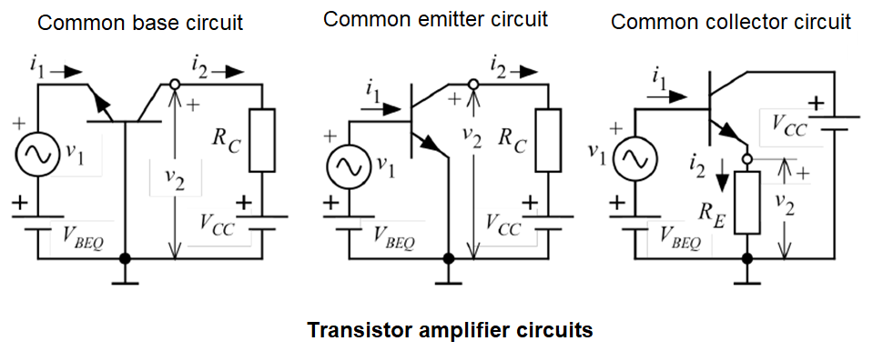
Transistor Amplifiers
Bipolar transistors can be used as voltage or current amplifiers. The transistor, which will work as a amplifier, can be connected in three different ways depending on the terminal selection to be used in the input and output ports: a) Common base circuit b) Common emitter circuit c) Common collector circuit (emitter output circuit) Connection formats:

Slide 12
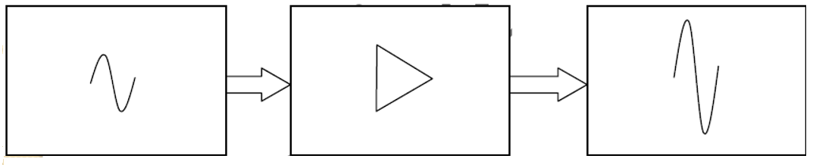
Transistor Amplifiers
Input Signal
Amplifier
Output Signal
Current Gain
Voltage Gain
Power Gain

Slide 13
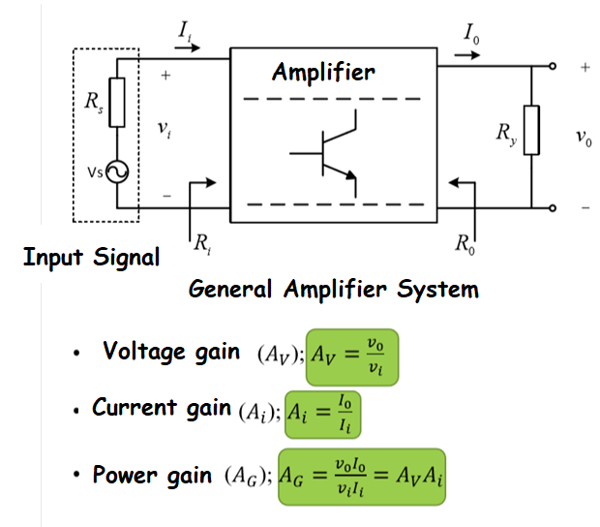
Block Diagram of Amplifier
General Definitions
Vs: Input Signal (sourse)
Rs: Source intrinsic resistance
Ri :Input resistance of amplifier
R0: Outpur resistance of amplifier
Ii:Input current
I0:Output current
Vi: Input voltage
V0:Output voltage

Slide 14
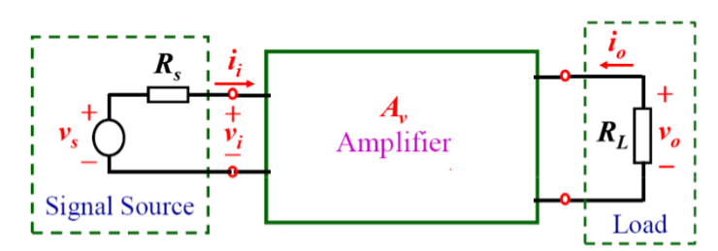
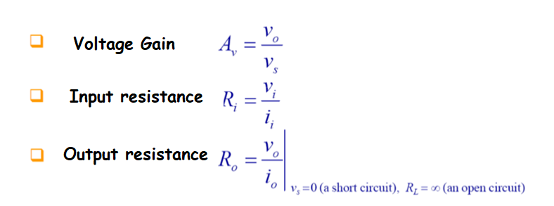
Block Diagram of Amplifier

Slide 15

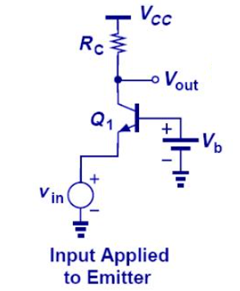


Common base circuit
The input sign is applied to the emitter.
The output is taken from the collector end.
If a voltage as small as is applied between the emitter-base after a DC current operating point is provided, the change in the collector current is as follows:
Since the voltage gain of the circuit is the ratio of the output voltage to the input voltage, the gain of the circuit is as follows:

Slide 16
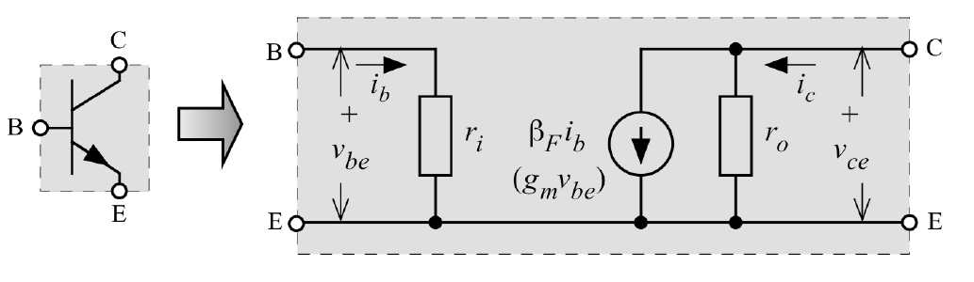
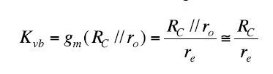

Common base circuit
The same equation can be easily achieved using the equivalent circuit as shown below:
Small signal model of bipolar transistor

Slide 17
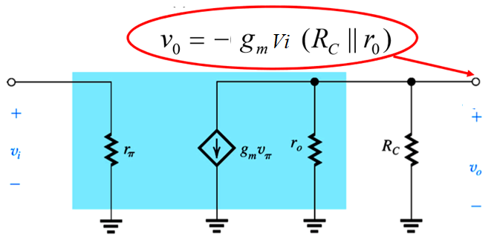
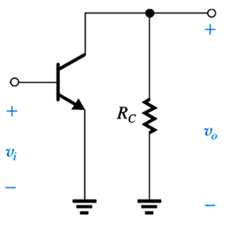

Common Emitter Circuit

Slide 18
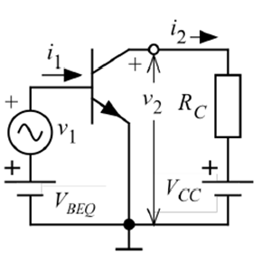
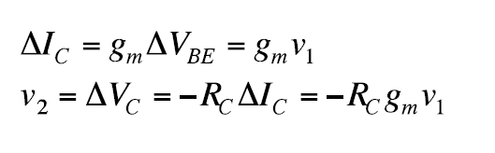
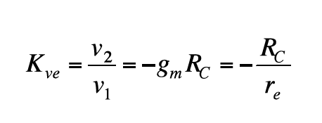
Common Emitter Circuit
It is also possible to calculate gain with another method:

Slide 19
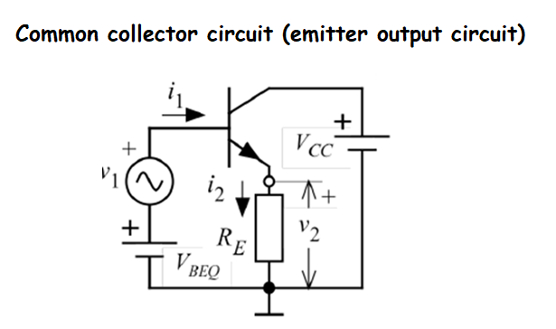
Common Collector Circuit (Emitter output circuit)
The circuit with common collector or commonly called emitter output does not provide voltage gain.

Slide 20
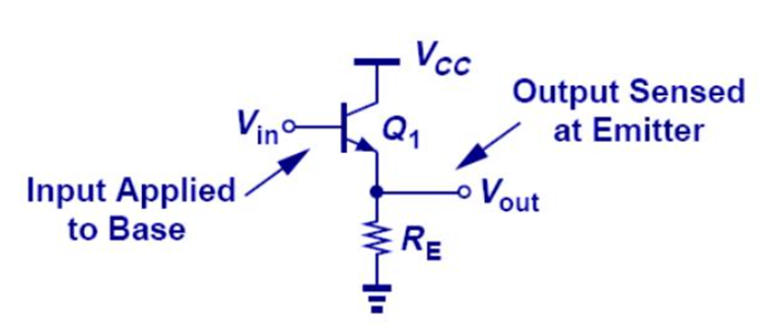
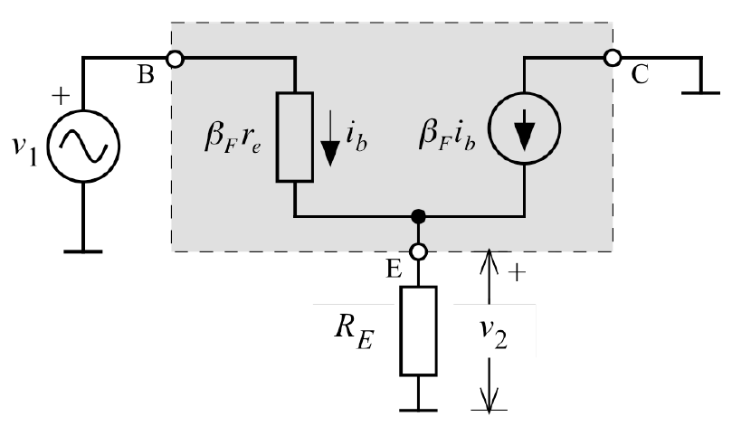
Common Collector Circuit (Emitter output circuit)
Equivalent circuit of emitter output circuit

Slide 21
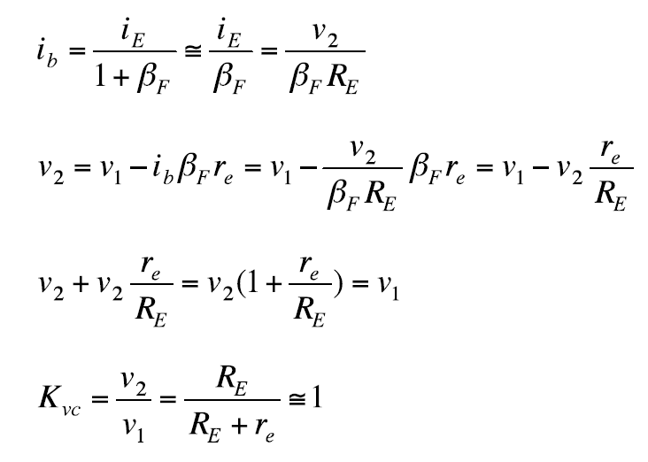
Common Collector Circuit (Emitter output circuit)
(1)
(2)
(3)
(4)

Slide 22
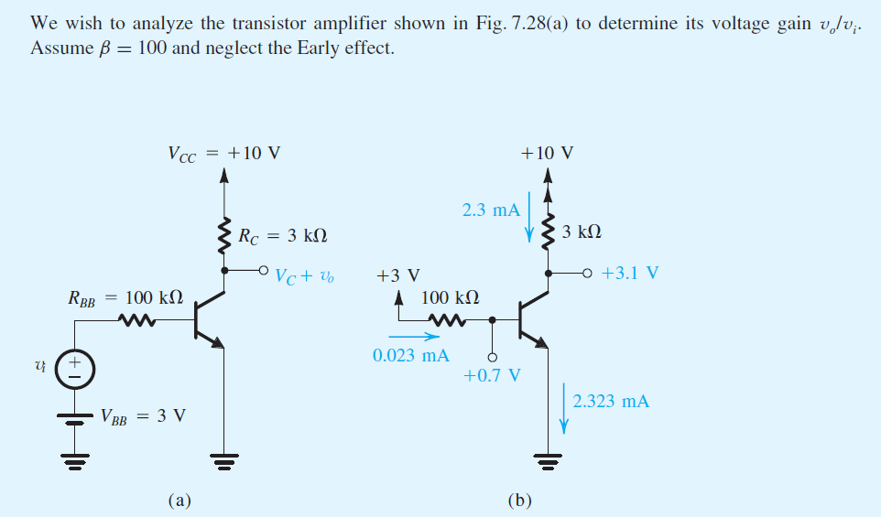

Slide 23
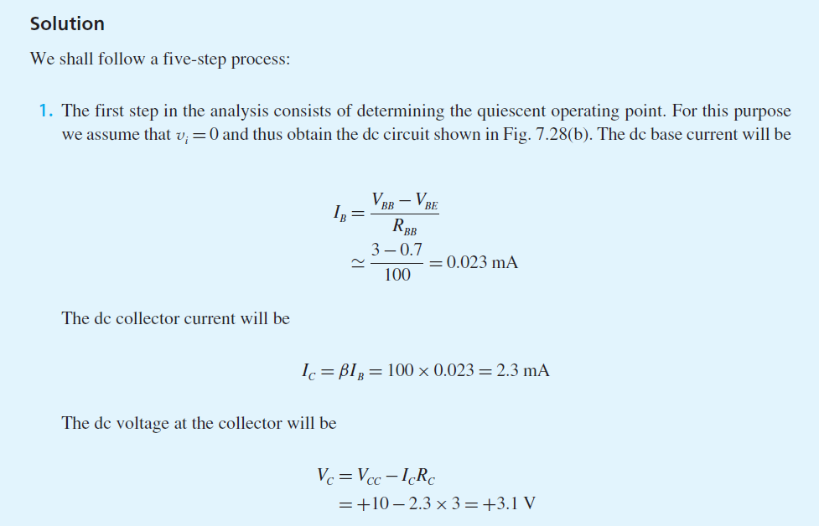

Slide 24
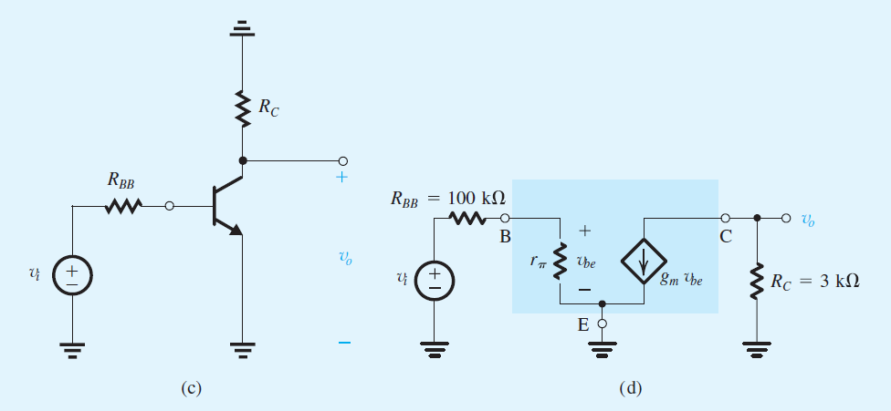

Slide 25
